Slide 1
Life Cycle of a Life Insurance Policy
Insurance Conclave – Bangalore ’08. Poster by Rakesh Pilli (samrakesh@in.ibm.com)

Slide 2


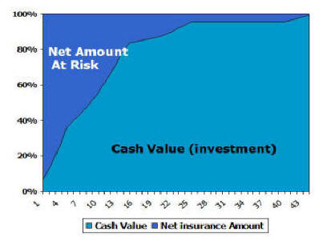

Every Insurance policy goes through many phases during its life cycle, important ones being Agent/Broker advice, Underwriting, Free-Look period and In-force period. During the in-force period, various benefits can be availed of by the Owner, such as Waiver of Premiums, Dividends and Non-forfeiture. The Policy Termination process can begin in more than one way, with the obvious one being the expiry of the insured. Once the term of a Term Life insurance policy is completed, it can either be terminated or be converted to a Whole Life policy. All other policies are terminated only after the complete payment of benefits to the Beneficiary.
Initial Policy Processing
Options
Reinsurance
Initial Policy Processing
Marketing
Agent/Broker
Form Filling/
Nomination
Underwriting
Policy Printed
Free-Look
Period
In-force
In the context of an Insurance industry, Underwriting is the process of assessing the risk of insuring against the occurrence of a future event
This refers to the 10-15 day wait period after premium calculations are done and before the customer signs the hard copy contract
A benefit wherein the Premiums are Waived in case of a disability to the policy owner.
A benefit wherein regular payments made to the owner in some type of policies
A provision wherein policy remains in-force even though Premium payments are defaulted
The policy can be replaced with another policy of the same company, a new company
In-force period
Policy Loans
Waiver of Premiums
Dividends
Rider Benefits
Bill Generation
Non-forfeiture
Reinstatement
Replacement
In case of lapse, policy can be reinstated by making due payments
Policy termination processing
Expiry of Insured
Claims
Verification of Expiry
One time payment
End of Term
Fixed Period Payment
Policy Lapse
Payment of Benefits
Policy Surrendered
Payment for Life
Policy Terminated

